Slide 1
Project Presentation of Co-Op Project at Industry (Module-2)
On
Analyzing Business Performance Gains from Cloud Adoption Using Data-Driven Approach
Name: Pratham Bajaj, Nayaja
Roll Number.: 2210992072, 2210991968
Supervised By
Dr. S.B. Goyal Dean
Department of Computer Science and Engineering,
Chitkara University, Punjab

Slide 2
Table of Contents
Introduction
Problem Statement
Methodology
Tools and Technologies
Findings and Outcomes
Code Snippets
Conclusion and Future Scope
References/Links used

Slide 3
Introduction
In recent years, advancements in information technology have significantly influenced the way businesses operate. Traditional IT infrastructure requires heavy investment in hardware, maintenance, and skilled personnel. Cloud computing has emerged as an alternative solution that provides on-demand access to computing resources such as storage, networking, and software services. This project explores how cloud computing improves business operations through a quantitative approach. Unlike traditional studies that focus on theoretical benefits, this project uses logistic regression to analyze efficiency improvements after cloud adoption. Cloud platforms such as AWS, Microsoft Azure, and Google Cloud allow organizations to scale resources dynamically and reduce operational complexity.
The study focuses on evaluating the impact of cloud computing on cost reduction, operational efficiency, and business continuity

Slide 4
Problem Statement
Traditional IT infrastructure involves high costs, limited scalability, and complex maintenance, which restrict business flexibility and efficiency. Organizations often struggle with resource utilization, system upgrades, and adapting to changing business needs such as remote work and real-time data access.
Although cloud computing provides a scalable and cost-effective alternative, there is still a lack of clear quantitative analysis of its impact on business performance. Most existing studies focus on general benefits like cost reduction and improved collaboration, but they do not measure actual efficiency improvements using data-driven methods.
Therefore, this project aims to address this gap by analyzing the impact of cloud computing on business operations using a data-driven approach. By applying logistic regression on pre- and post-adoption data, the study evaluates improvements in operational efficiency and overall performance.

Slide 5
Methodology
The research adopts a quantitative experimental methodology to analyze the impact of cloud computing on business performance. The study focuses on organizations that have transitioned from traditional IT infrastructure to cloud-based systems. A before-and-after comparative approach is used, where key performance indicators such as operational cost, efficiency, and system reliability are evaluated prior to and following cloud adoption. This approach enables a clear understanding of the direct effects of cloud integration on business operations.
For data collection, relevant organizational data was gathered from multiple sources, including operational cost records, system performance metrics, and efficiency indicators. The data primarily captures expenditure patterns before cloud adoption and the subsequent reduction in costs and improvements in performance after migration. The dataset also incorporates factors such as remote work enablement, resource utilization, and system accessibility, providing a comprehensive view of business transformation driven by cloud technology.

Slide 6
Tools and Technologies
Platform Used: Google collab/ Anaconda
Required Libraries: pandas, Numpy, matplotlib, scikit-learn.
Language Used: Python
Requirement: Python 3.10

Slide 7
Finding and Outcomes
The findings of this study highlight that cloud computing significantly improves business performance across cost, efficiency, and reliability dimensions. A key outcome is the reduction in operational costs, as organizations shift from capital-intensive on-premises infrastructure to a pay-as-you-go cloud model. The analysis shows substantial annual savings, demonstrating how cloud adoption helps optimize financial resources while maintaining scalability.
In addition to cost benefits, cloud computing enhances operational efficiency by enabling remote access, better resource utilization, and faster data processing. The study identifies efficiency improvements of up to 30%, with logistic regression analysis indicating that, with proper implementation and training, efficiency can increase by as much as 2.5 times. This supports the role of cloud technology in enabling flexible work environments and improving productivity.
Additionally, cloud computing improves disaster recovery and business continuity through effective backup and recovery mechanisms. Overall, the findings confirm that cloud adoption is a cost-effective and strategic approach to achieving greater agility and long-term operational success.

Slide 8
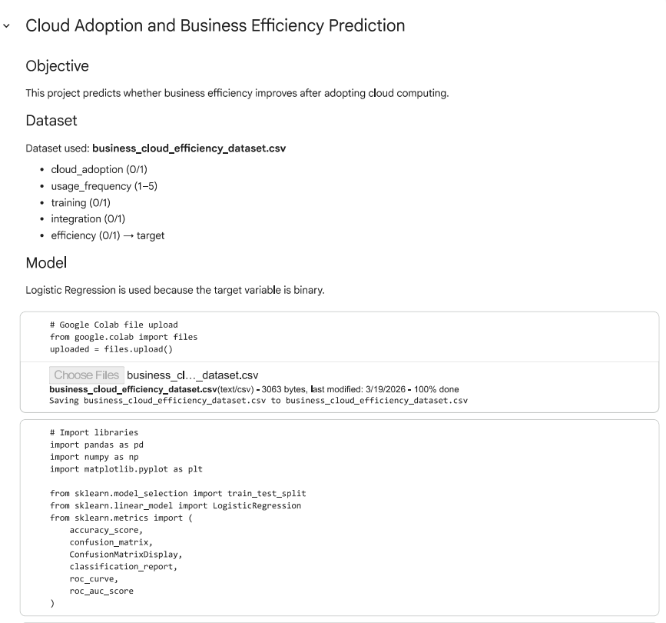
Code Snippets

Slide 9
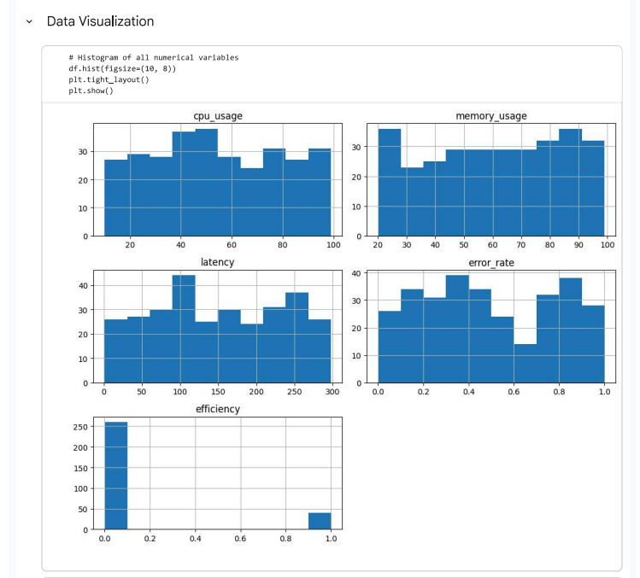
Code Snippets

Slide 10
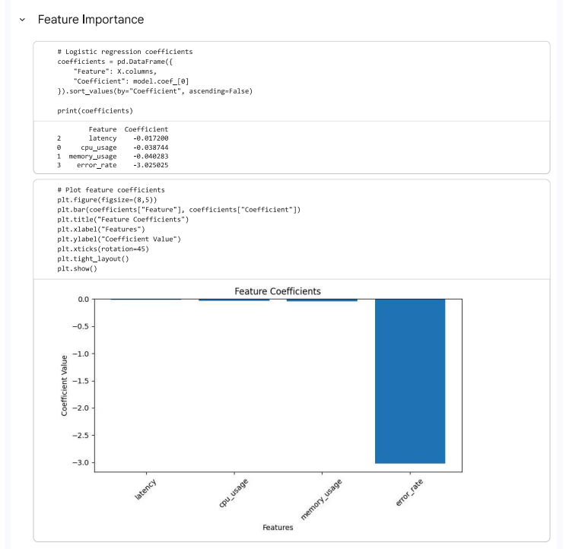
Code Snippets

Slide 11
Conclusion and Future Scope
In the future, this study can be extended by applying advanced machine learning techniques such as Random Forest and Neural Networks to improve prediction accuracy. The use of larger and more diverse datasets from multiple industries can further enhance the reliability of results. Additionally, integrating cloud computing with emerging technologies like Artificial Intelligence and IoT can provide deeper insights into smart business systems. Real-time data analysis and cloud monitoring can also be explored to better understand dynamic business environments.
Furthermore, the study highlights that cloud computing enables organizations to respond quickly to changing market demands by providing scalable and flexible infrastructure. It also reduces dependency on physical resources and enhances decision-making through better data accessibility. The findings reinforce that cloud adoption supports digital transformation and helps organizations remain competitive in a rapidly evolving technological environment.

Slide 12
References
Mell, P., Grance, T.: The NIST Definition of Cloud Computing. National Institute of Standards and Technology (NIST), U.S. Department of Commerce (2011)
Armbrust, M., Fox, A., Griffith, R., et al.: A View of Cloud Computing. Communications of the ACM 53(4), 50–58 (2010).
CXO Content: Evolution and the Future of Cloud Computing [Internet]. Available at: https://cxocontent.com/future-of-cloud-computing-inception-to-edge-computing/ (2021). Accessed 2026.
Wikipedia: Cloud Computing [Internet]. Wikimedia Foundation. Available at: https://en.m.wikipedia.org/wiki/Cloud_computing (2022). Accessed 2026
Tutorials Point: Cloud Computing Challenges [Internet]. Available at: https://www.tutorialspoint.com/cloud_computing/cloud_computing_challenges.htm (2022). Accessed 2026
SWZD: Cloud Trends in 2021 and Beyond: Remote Work Drives Adoption [Internet]. Available at: https://swzd.com/resources/cloud-trends/ (2021). Accessed 2026
Rapyder: What is Disaster Recovery & Its Importance for Business [Internet].Available at: https://www.rapyder.com/blog/disaster-recovery-in-cloud-computing/ Accessed 2026

